Slide 1
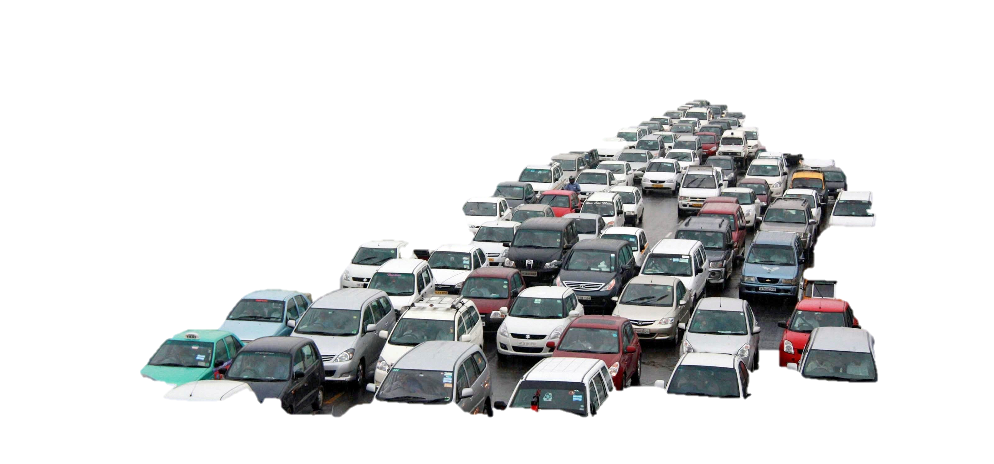
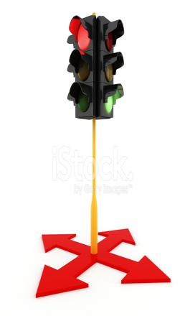
<BootcV/>

Slide 2
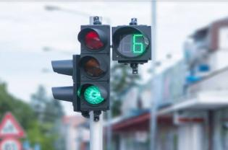
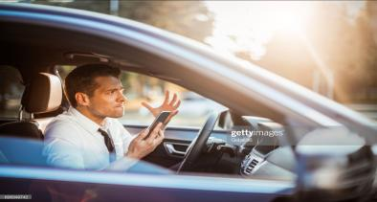
Introduction
In the country like India with huge population, traffic management is still a challege to face.
People has to wait for long time standing in the queues at the traffic signals which makes them very irritating and annoying at the same time.

Slide 3
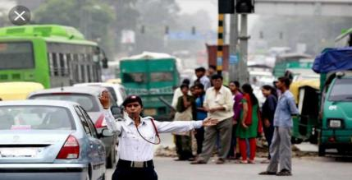
Problem
In today`s scenario the entire traffic management is done manually.
People has to wait for a specific time at the signals even if the opposite lane is empty.
Sometimes when the traffic is very huge it becomes very difficult for the traffic police to manage the
situation.
Large queue of the traffic leads to:
- pollution
- mental stress
- delay,etc.

Slide 4
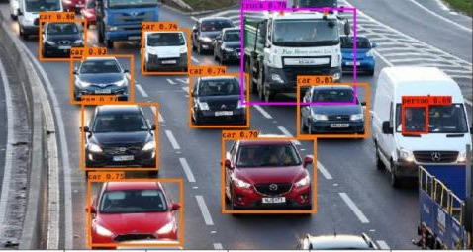
Solution
Solution to this is smart traffic lights:
The volume of the traffic is detected through image processing. Time of the lane with the least traffic will be reduced and the same will be added to the time with the huge traffic.
This will reduce the time people
use to wait at the signals.

Slide 5
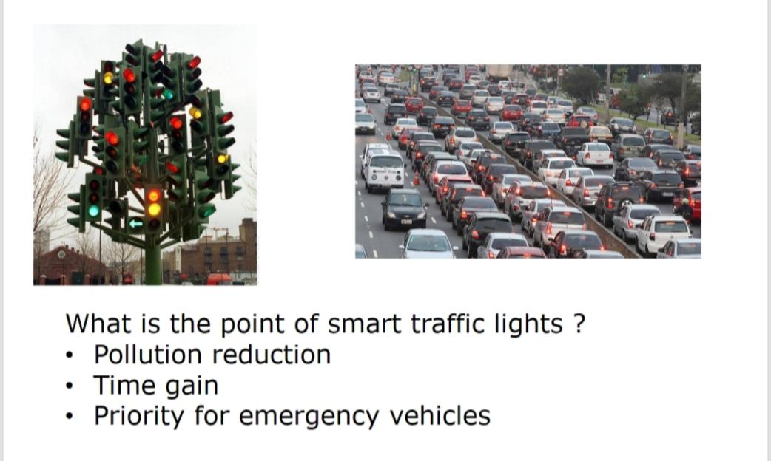

Slide 6
Objective
Detect Cars on roads.
Traffic lights control based on number of cars in each row.
By Priority lane signals will be change and Priority will be give to
the lane with huge volume and the waiting problems can be solved.

Slide 7


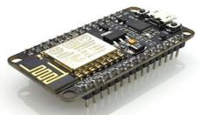

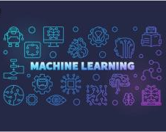
Technologies used

Slide 8
Future scope
Give the priority to large vehicles like fire engines in order to manage emergency, decrease pollution and traffic jams.
An Application can be developed which will guide a person to take the best route with least traffic in order to save the time
with actual signal density.

Slide 9
Presented-by
Team : Techno_Feminine
Aditya Soni
Shefali Arora
Surbhi SInghal
Saksham taneja
Presenting at: IIS_Hackthon_JAipur

